Slide 1
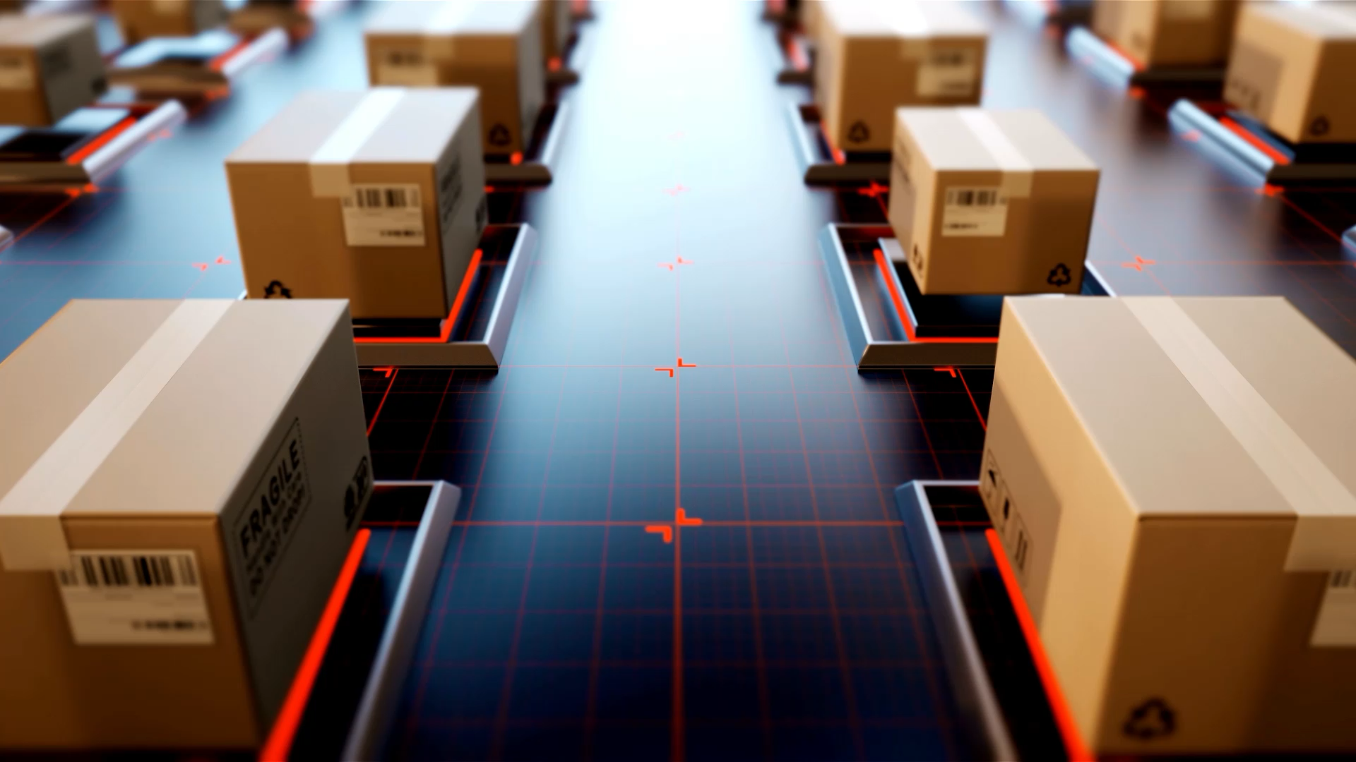
Introduction to Object Detection and Tracking
Traditional Methods in Computer Vision

Slide 2

What is Object Detection and Tracking?
Object Detection:
- Identifying and localizing objects in images or video.
- Output: Bounding boxes with class labels.
Object Tracking:
- Following detected objects over time in video.
- Output: Trajectories of objects across frames.

Slide 3

Importance of Object Detection and Tracking
Applications:
- Autonomous vehicles, surveillance, sports analytics, augmented reality.
Challenges:
- Occlusions, lighting variations, real-time performance.

Slide 4
Traditional Methods for Object Detection
Feature-Based Detection (e.g., Haar Cascade Classifier).
Template Matching: Matches predefined templates.
Advantages: Lightweight and computationally efficient.

Slide 5
Traditional Methods for Object Tracking
Kalman Filter:
Recursive filter for estimating motion states.
Mean-Shift Algorithm: Moves bounding box to pixel-dense regions.
Optical Flow: Tracks pixels based on motion.

Slide 6
Implementing Object Tracking Using OpenCV
Kalman Filter:
Predicts and updates object states.
Steps:
1. Initialize Kalman filter parameters.
2. Predict the next state.
3. Update the state with measurements.

Slide 7
Summary
Object detection identifies and localizes objects.
- Object tracking follows objects over time.
- Haar Cascade and Kalman Filter are traditional, efficient methods.
- Explore modern deep learning methods.

Slide 8
Q&A
Any Questions?

